Slide 1

JOB ROLE PREDICTION USING MACHINE LEARNING
Team Members
Girija Kondapally [GirijaKondapally@my.unt.edu]
Manasa Cherukupally [ManasaCherukupally@my.unt.edu]
Shiva Chittimalla [ShivaChittimalla@my.unt.edu]
Durga Phani Vikas Telu [DurgaPhaniVikasTelu@my.unt.edu]
Rahil Zuhair Mohammad [RahilMohammedZuhair@my.unt.edu]

Slide 2
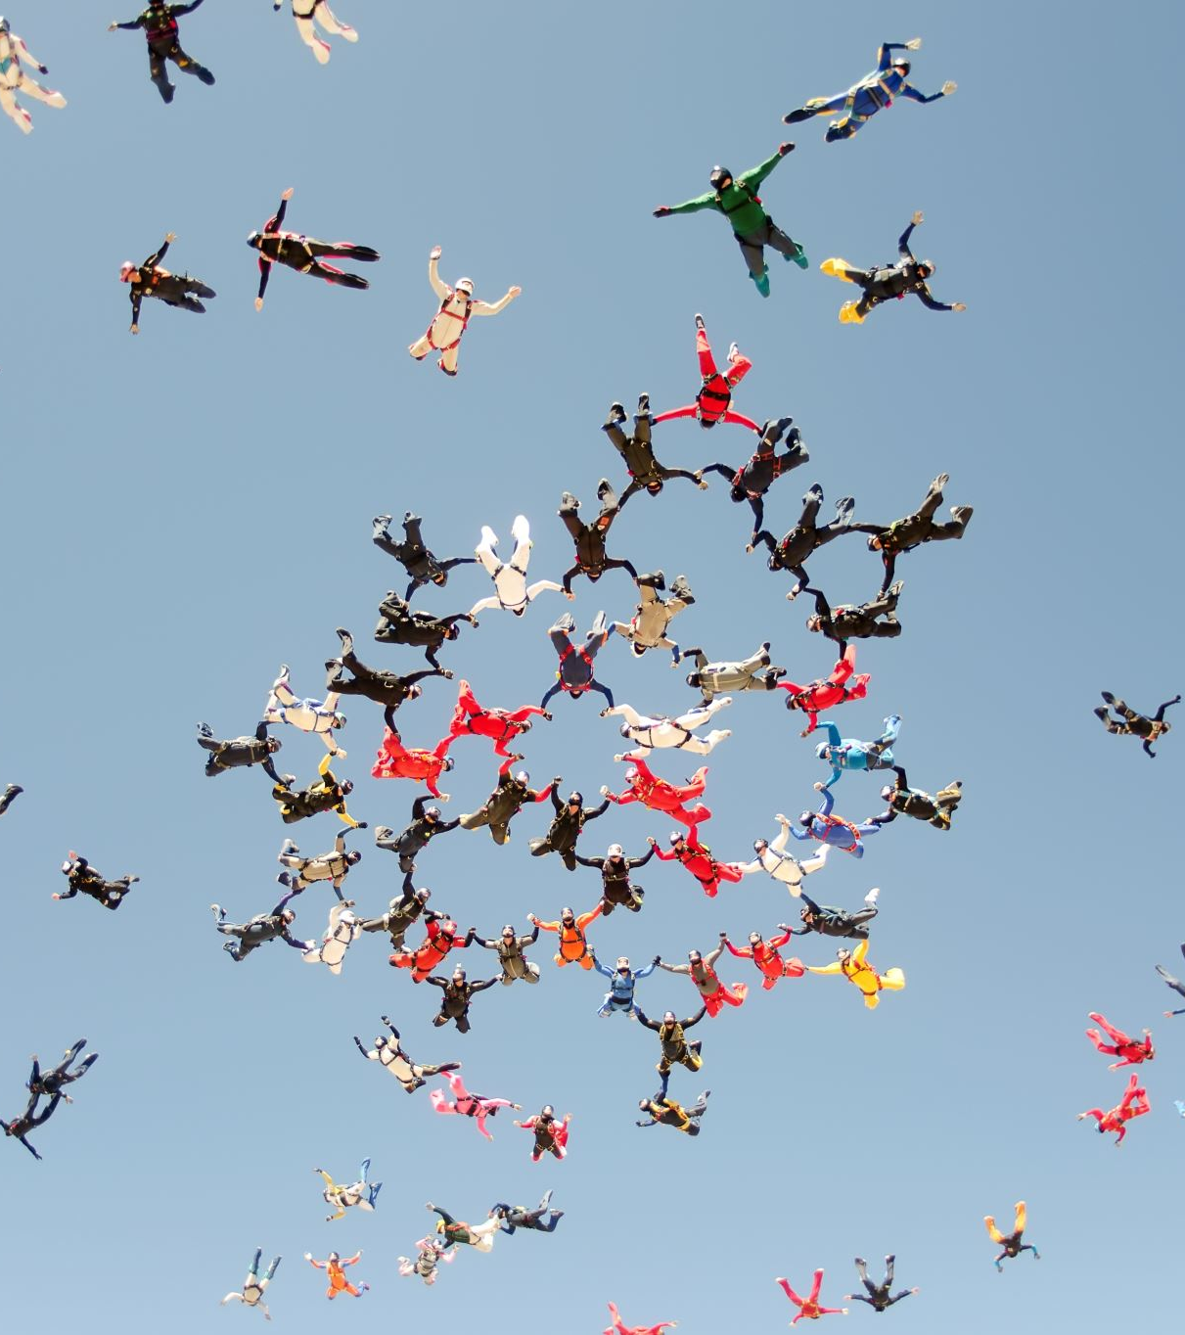
Roles and responsibilities
Finding, cleaning, and preprocessing the data: Girija and Manasa.
Exploring and dealing with SVM (Support Vector Machine), decision tree and random forest: Durga Phani Vikas and Rahil
Exploring and dealing with Naive Bays and K-neighbor: Shiva
Exploring and dealing with Ada boosting, gradient boosting: Girija and Manasa
Report and Presentation: All were involved in this step

Slide 3

Abstract
This project aims to help graduate students choose the right career path using machine learning algorithms. Many students are confused about their future and struggle to identify their abilities and a suitable domain.
By predicting the best career option and domain based on personal and academic information, this tool will guide students towards a specific domain aligned with their skills.
The project will also compare the accuracy of different machine learning algorithms to gain knowledge on their usage scenarios. With numerous software fields available, this tool will be beneficial for students to recognize their job field by the skills they possess.

Slide 4

Workflow
Week-1: Working on exploring the data set and tried to explore other datasets too. This is for getting a better fit to our idea of the project.
Week-2: Start of preprocessing steps like data cleaning, outliers, any transformations.
Week-3: Worked on the algorithms. As we can observe that our target variable, it is a categorical data and we have labeled data so we will explore classification techniques like Navie Bayes, SVM, Decision Tree etc.
Week-4: Focused on the accuracy of suggesting job role. Which algorithm gives best accuracy score and documenting the project.

Slide 5
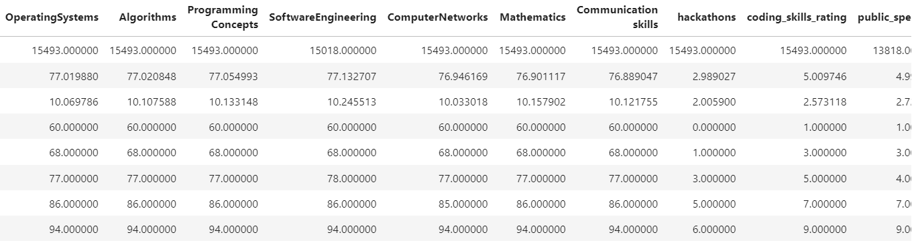
Dataset

Slide 6
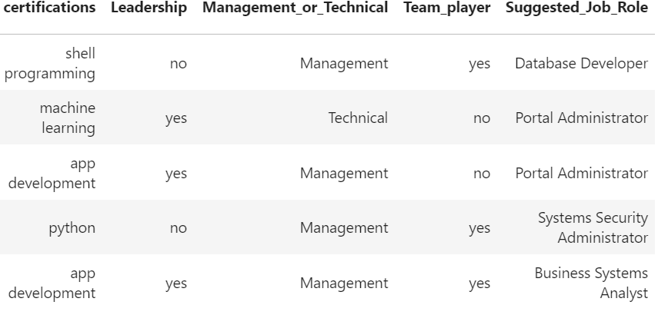
Dataset

Slide 7
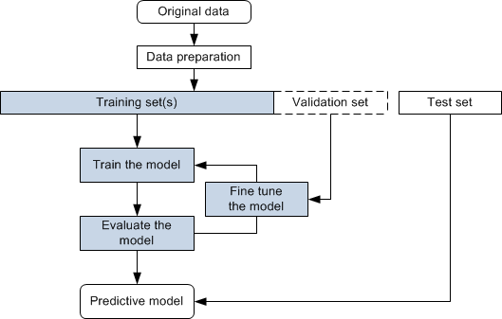
flowchart

Slide 8
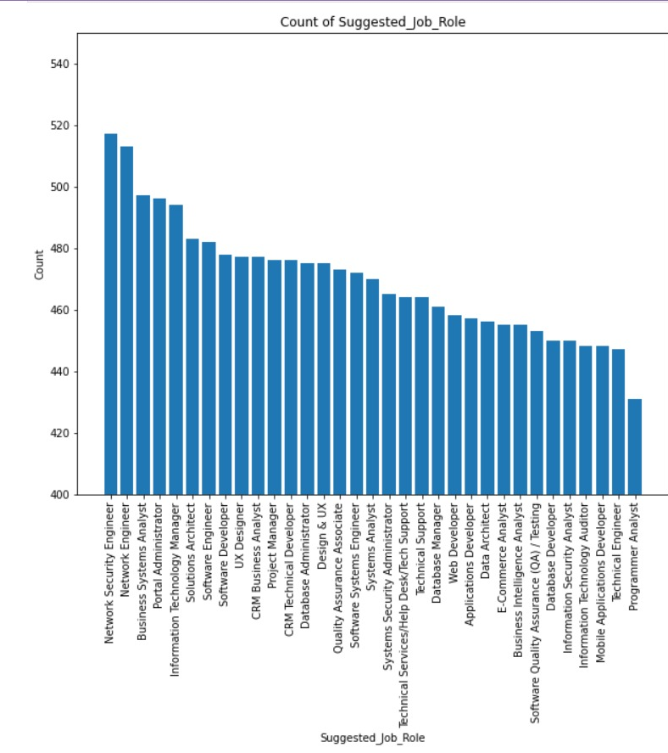
Initial visualizations 0f data…

Slide 9
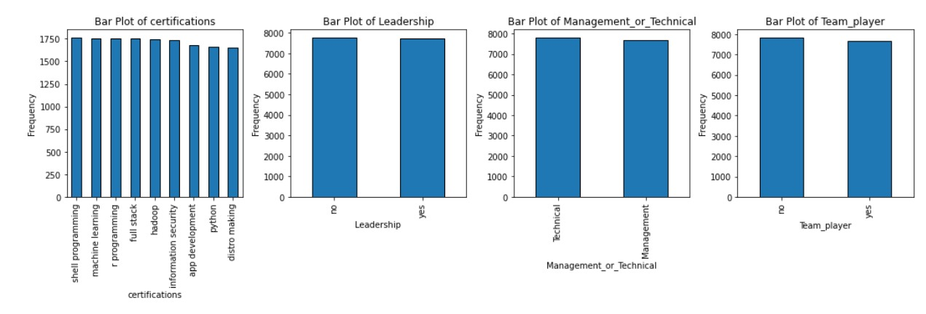
Initial visualizations 0f data…

Slide 10
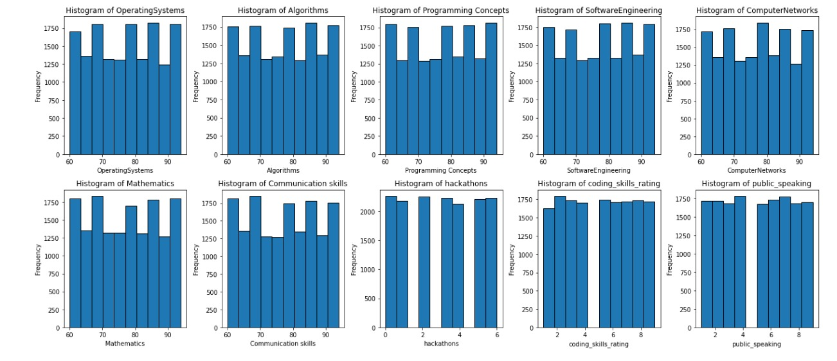
Initial visualizations 0f data…

Slide 11
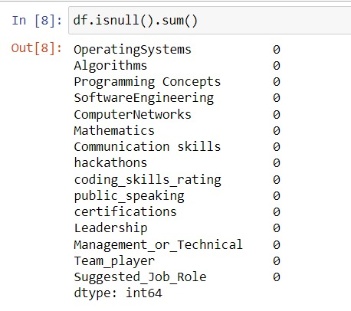
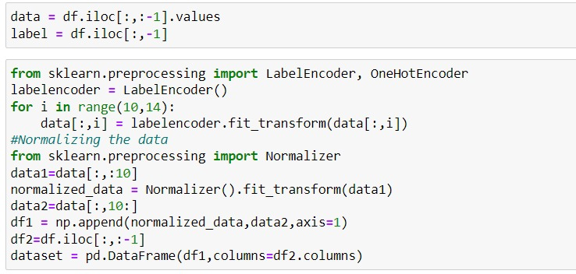
Data preprocessing

Slide 12
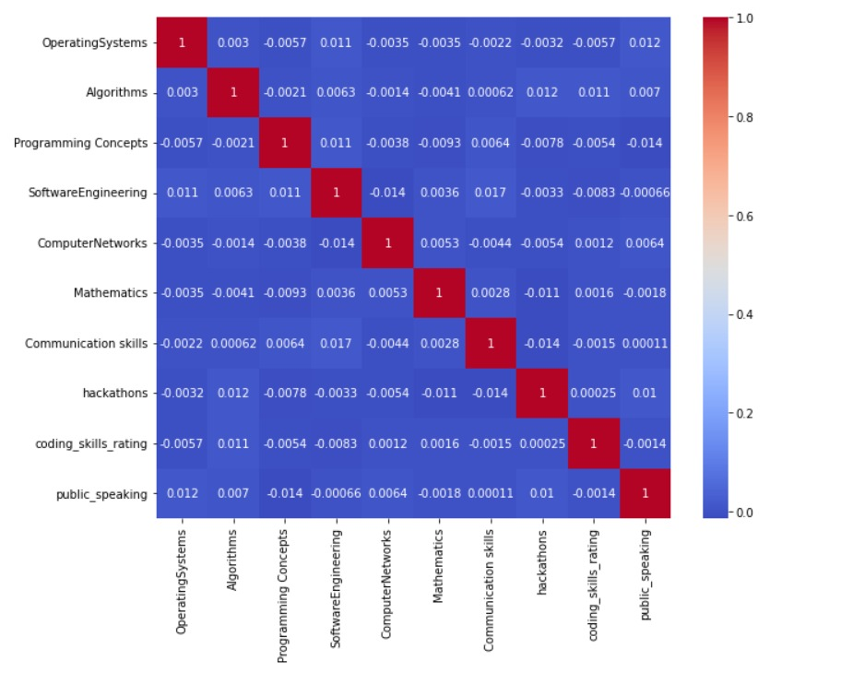
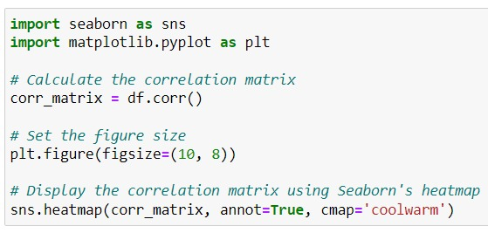
Data preprocessing

Slide 13
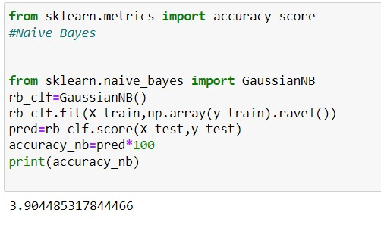
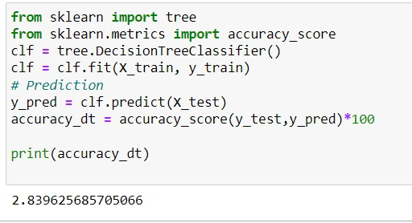
Code snippets of algorithms we used

Slide 14
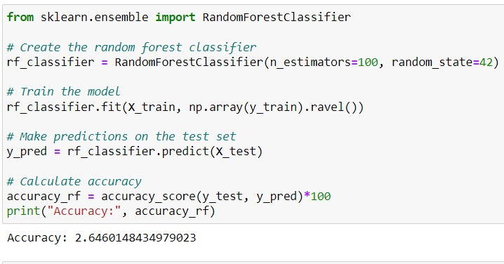
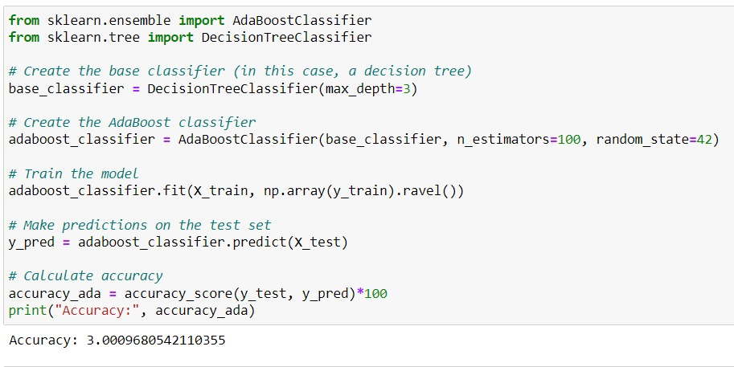
Code snippts of the algorithms used

Slide 15
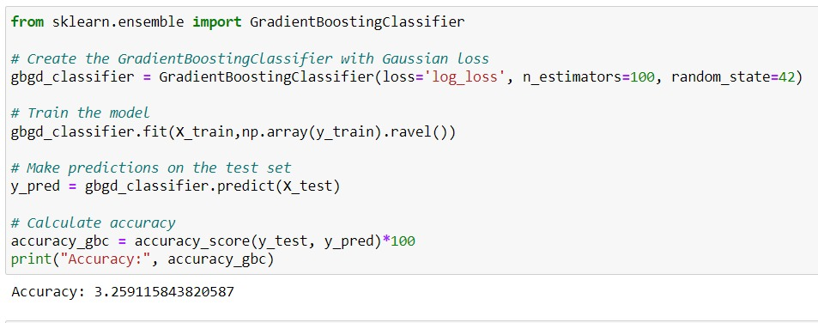
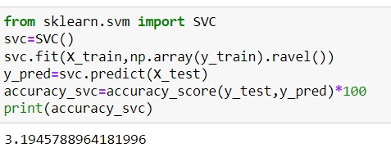
Code snippets of the algorithms used

Slide 16
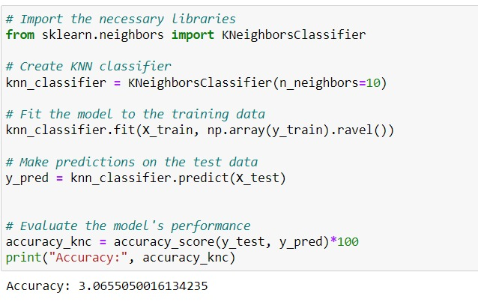
Code snippets of the algorithms used

Slide 17
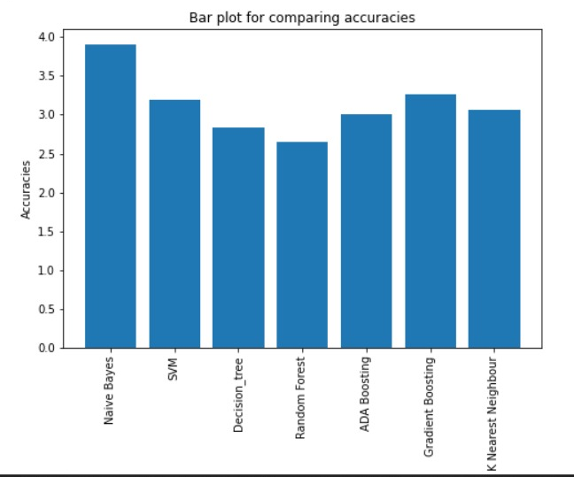
Output

Slide 18

Future Scope
In Future we would have planned to develop an interactive User Interface which takes input of all this data which we had shown in the excel and stores in a database and shows the results if the data is given to the algorithm to run a model.

Slide 19
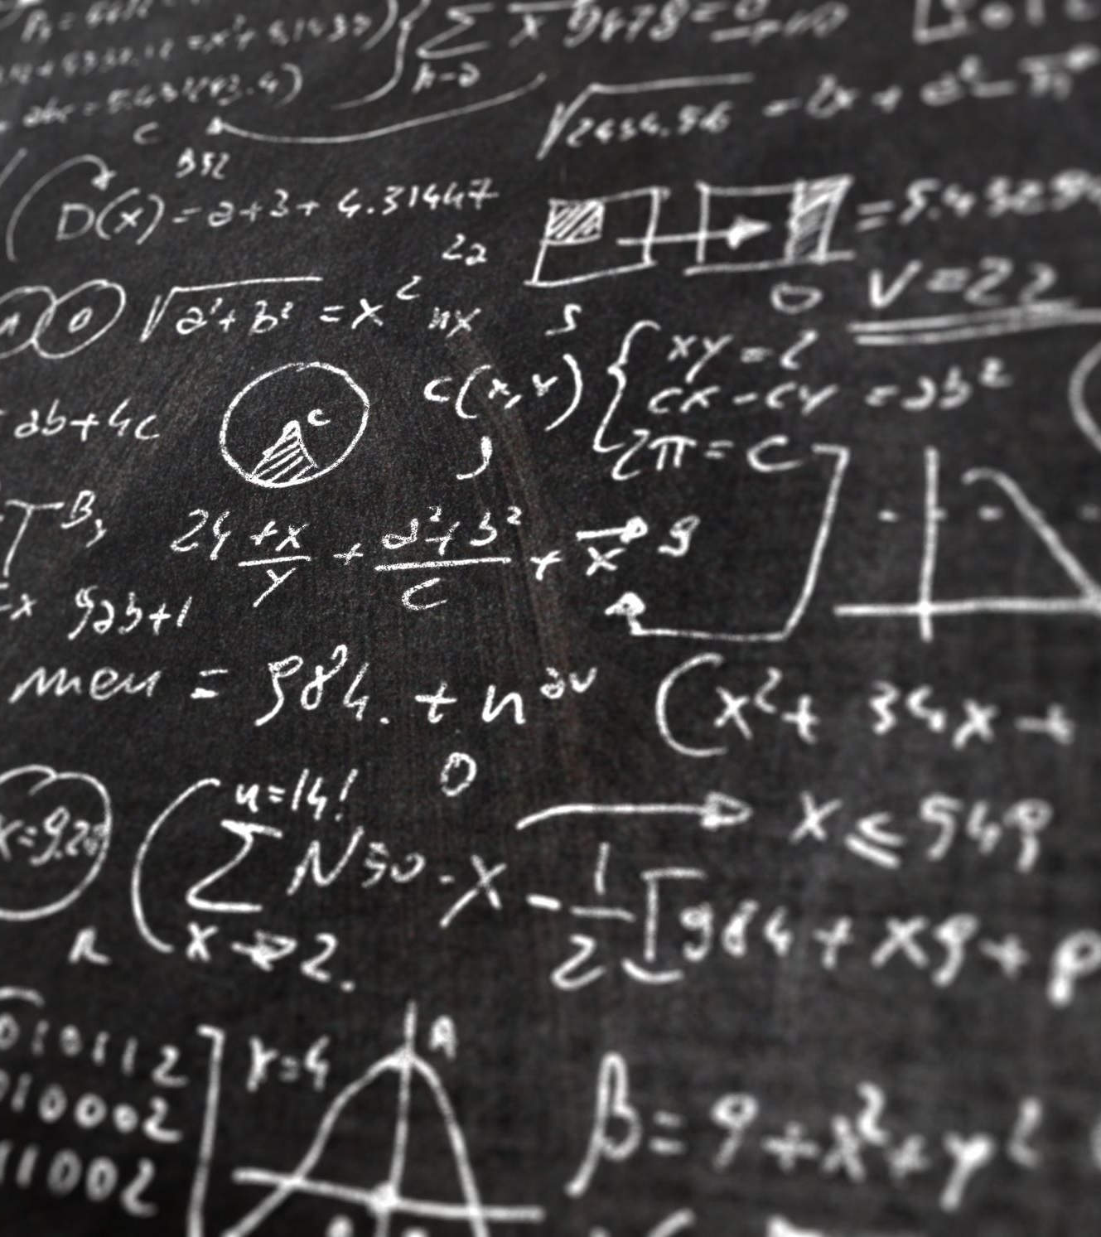
References
[1] P.KaviPriya, “A Review on Predicting Students’ Academic Performance Earlier, Using Data Mining Techniques”, International Journal of Advanced Research in Computer Science and Software Engineering
[2] Ali Daud, Naif Radi Aljohani, “Predicting Student Performance using Advanced Learning Analytics”, 2017 International World Wide Web Conference Committee (IW3C2).
[3] Bo Guo, Rui Zhang, “Predicting Students Performance in Educational Data Mining”,2015 International Symposium on Educational Technology.

Slide 20

Thank you

